Slide 1
KS4 Information Evening
Who is here tonight?
Pastoral team:
Mr Kent, Head of KS4
Mrs Odero, KS4 Pastoral Support
Mrs Jones, Student Receptionist
SLT
Mr Jones – Assistant Head
Ms Verney – Assistant Head
Mr Atkin – Associate Head and Subject Leader (PE)
Safe-guarding and Inclusion team:
Mrs Pawlak, Safeguarding and Inclusion Manager & Designated Safeguarding Deputy
Mrs Thompson, Designated Safeguarding Deputy
Mrs Rembges, Designated Safeguarding Deputy
Student Support team:
Mrs Brocklesby, SENCo
Please use the time before and after the presentation to talk to us and ask any questions you may have.

Slide 2
Year 10
What does it mean?
Student Wellbeing.
GCSE learning examination skills.
Academic success.
Form groups replaced by academic classes.
Work experience
Challenge & expectations.

Slide 3
Silverdale GCSE structures
Triple Science Students | Combined Science students
8 lessons of English (Language & Literature) 7 lessons of Mathematics. | 8 Lessons of English (Language & Literature) 7 Lessons of Mathematics.
15 Science lessons. Biology, Chemistry & Physics – 5 hours each subject. | 9 science lessons. (Biology, Chemistry & Physics 3 hours each subject)
3 options subjects – 6 hours each option. | 4 options subjects – 6 hours each option.
2 lessons of Physical Education. | 2 lessons of physical education.

Slide 4
How is attainment measured, tracked and communicated in KS4?
Explaining assessment points:
Attitudes to learning 5 times in Y10.
Attainment 3 times in Y10. Current teacher assessed working grades & mock exam results.
End of KS4 targets for each subject.
Achievement points students V Silverdale average.
Behaviour points students V Silverdale average.
Attendance & lates.

Slide 5
Academic Support
Revision Materials through Parent Pay.
Subject support.
Preparation for Y10 mocks.
Key stage parental support meetings.
Supporting communications with staff.
Form tutor mentoring.
School website examination information & support.

Slide 6
How does the Pastoral team support your child’s learning?
Direct link for you as parents/carers to answer and deal with enquiries.
Supporting the emotional wellbeing of students.
Providing a ‘Safe Space’ for students.
Managing behaviour and sanctions.
Offering ongoing meetings to support parents and carers.
Investigating and ensuring fairness when dealing with incidents.
Developing personalised provision to promote inclusion.
Working with SENCO, Wellbeing, Safeguarding and SLT.
Monitoring, tracking & reporting academic progress.

Slide 7
Year 11
What does it mean?
Leadership
Preparing for GCSE
Further Independency
Increasing confidence
Role-models
Challenge

Slide 8
The most effective practice
Student
Pastoral Team
Form tutor
Parents/Carers
SLT/ Wellbeing/ Safeguarding/ SENCO
Other agencies

Slide 9
We’re here to work with you.

Slide 10
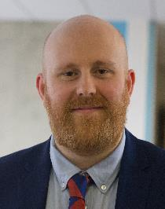
Behaviour and expectations
Assistant Headteacher Mr Jones
Notes:
Who am I?
Roisin/ Chas etc
Excited to be Co-head this year…m Joined the school as deputy last year, thoroughly enjoyed my year and even more excited to be given the opportunity to be co-head of school this year.
Chorus Education Trust
Mrs Housley

Slide 11
At Silverdale we are always…. …Ready, Respectful, and Safe.

Slide 12
Silverdale School Expectations
Follow all instructions; first time, every time.
Arrive on time, fully equipped and ready to learn.
Try your best at all times.
Take pride in yourself and respect others.
Complete all classwork and homework to the highest standard possible for you to be ready for the next stage.
Respectfully listen to those who are meant to be talking – adults and students.

Slide 13
Mobile Phone free zone
Mobiles and headphones are not allowed in school for Years 7 to 11. ​
They should be put in bags, turned off, at the gate to school.​
At no time in the school day should they be used.​
If seen, the phone is confiscated and delivered to your key stage office.
If there is a reoccurring issue with phones we will contact home.

Slide 14
Why are we a Mobile Phone free zone?
Mobiles and headphones are not allowed in school for Years 7 to 11. Sixth Formers are only allowed in certain zones. ​
Unesco, the UN’s education, science and culture agency, said there was evidence that excessive mobile phone use was linked to reduced educational performance and that high levels of screen time had a negative effect on children’s emotional stability.
‘Mobile phones are not just distracting, but when misused or overused, they can have a damaging effect on a pupil's mental health and wellbeing.’

Slide 15
Being school-ready: equipment
Students are expected to come to school with the correct equipment for learning.
Every student must bring to school every day:
a bag
a pen
a pencil
a planner
and a ruler.
Every student should bring to school every day:
a pencil case
a green pen
a spare pen
an eraser
a scientific calculator
a glue stick
a highlighter.

Slide 16
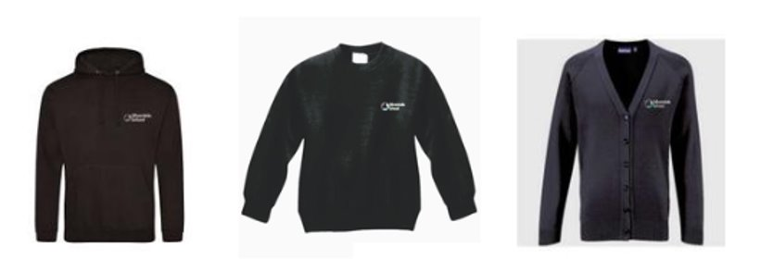
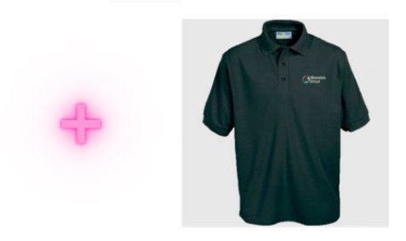
Being school-ready: uniform
Black polo shirt with school logo.
Black sweatshirt with school logo, black hoodie with school logo.
We encourage students to have a coat that is waterproof.

Slide 17
Being school-ready: uniform
Black polo shirt with school logo.
Black sweatshirt with school logo, black hoodie with school logo.
Black cardigan with school logo.
Black tailored trousers (loose fitting, plain style, not tight around the ankle, at least ankle length - no denim, jeggings, jeans or chino style).​
Black tailored shorts (loose fitting, mid-thigh length or longer) or Black tailored skirts (no denim or tube skirts). These must be suitable for a professional setting.​
Tights must be plain black with no patterns or holes.​
No additional trousers, tracksuit bottoms or shorts are to be worn underneath.
Religious headdress if appropriate. No other headwear is allowed.
Full details (including PE kit and how to order) are on the school website (www.silverdale-chorustrust.org/uniform).

Slide 18
Safety on Corridors
In addition to our one-way system, to make all aspects of the school day safer we have introduced a Hands Off rule.
This means that students should not be pushing and placing their hands on each other inappropriately and head straight to lessons.
Our first response to students that are not following the 'Hands Off' expectation is to give them a friendly and supportive reminder of the expectations we have that no non-necessary touching taking place.
We have introduced this to strengthen pupil safety and maintain a purposeful walk to lessons.​

Slide 19
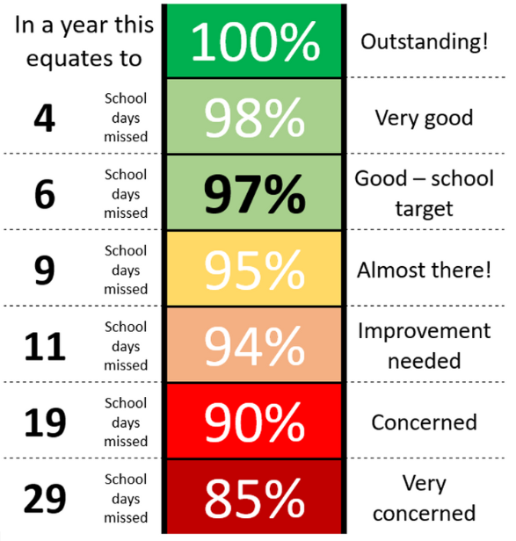
Attendance
Silverdale School supports Sheffield City Council’s policy regarding holidays during term time.
Silverdale School will not authorise holidays during term time.
‘Exceptional circumstances’ requests can only be approved by the Headteacher.
If attendance becomes a ‘cause for concern’ we will request medical evidence in order to authorise absences.
Full details at: www.silverdale-chorustrust.org/attendance

Slide 20
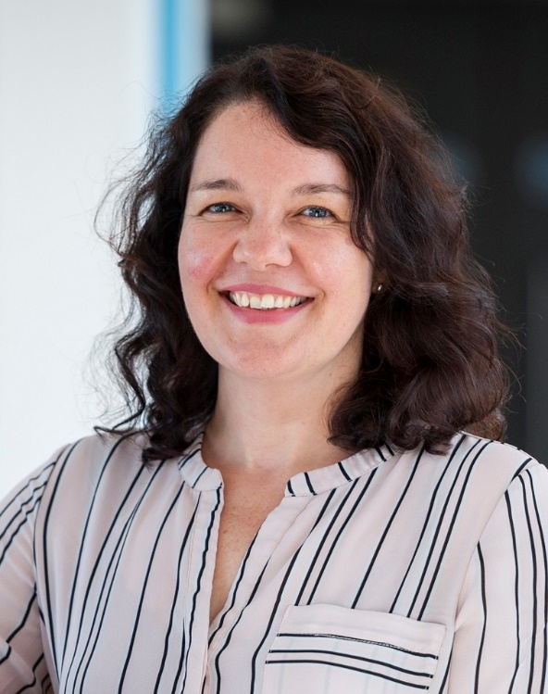
Teaching and Learning and Academic Inclusion
Assistant Headteacher Ms Verney
Notes:
Who am I?
Roisin/ Chas etc
Excited to be Co-head this year…m Joined the school as deputy last year, thoroughly enjoyed my year and even more excited to be given the opportunity to be co-head of school this year.
Chorus Education Trust
Mrs Housley

Slide 21
Questions
How can I find out what my child is studying?
What do I do if I think my child is struggling academically?
How can I talk to my child about their future choices?
Notes:
Who am I?
Roisin/ Chas etc
Excited to be Co-head this year…m Joined the school as deputy last year, thoroughly enjoyed my year and even more excited to be given the opportunity to be co-head of school this year.
Chorus Education Trust
Mrs Housley

Slide 22
How can I find out what my child is studying?
Booklet page 4

Slide 26
What do I do if I think my child is struggling academically?
Booklet page 7

Slide 27
How can I talk to my child about their future choices?

Slide 28
Work Experience – Summer Term 2024:
-Assemblies
-PSHE GRIT day (time off timetable)
-Letters home
Careers appointment in school by independent careers adviser.

Slide 29
Communications: How to contact school
What would you like to talk about? | Who do you contact?
Well-being (family, friendship groups, worries) Teaching and learning (homework, assessment, progress) Uniform and equipment Behaviour | Mrs Odero (KS4 Pastoral Manager) Mr Kent (KS4 Leader)
Holidays or time off school Attendance | Mrs Austin (Attendance Officer)
Medical issues (changes to health, such as allergies) | Mrs Jones (Student Receptionist)
Safe-guarding – concern about the safety of a child | Mrs Pawlak (Safe-guarding Manager)
Concern about a learning need (reading, concentration, organisation) | Ms Brocklesby (Special Needs Coordinator - SENCo)

Slide 30
Thank you for coming.
Please leave feedback and any questions on the sheet at the front.

